Slide 1
Bayes’ Theorem

Slide 2
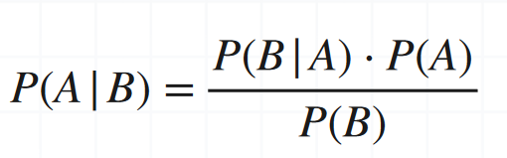
Bayes’ Theorem
Bayes’ Theorem
Extended form of conditional probability
Conditional Probability: Focuses on calculating a single forward-looking probability based on the relationship between two events, and allows the calculation of P(A|B) – One condition
Bayes’ Theorem: Allows us to calculate the reversed conditional probability, P(B|A), and incorporates both probabilities P(A|B) and P(B|A) in one formula – Two conditions
Example: Next slide

Slide 3
Conditional Probability and Bayes’ Theorem
Event A: Applicant gets a loan approval (Suppose historically 70% of applicants get approved, so P(A) = 0.7)
Event B: Applicant has a good credit score (New information)
Conditional probability
Imagine the bank only cares about the credit score (B) and wants to know the likelihood of approving a loan (A) given a good credit score
Suppose 60% of applicants with good credit get approved (P(A and B) = 0.6)
Also suppose 80% of applicants typically have a good credit score (P(B) = 0.8)
P(A|B) = P(A and B) / P(B) = 0.6/0.8 = 0.75 or 75%
Considers a single condition and then gives probability estimation

Slide 4
Conditional Probability and Bayes’ Theorem
Event A: Applicant gets a loan approval (Suppose historically 70% of applicants get approved, so P(A) = 0.7)
Event B: Applicant has a good credit score (New information)
Bayes’ Theorem
Now, suppose that the bank receives an application and the applicant has a good credit score (B) - This is new information
Bayes' theorem allows the bank to update its initial belief about the applicant getting a loan (A) based on this new information
We want P(A|B)
We know, P(B) = 0.8 and suppose P(B|A) = 0.8 … Probability of applicant having a good score given that the loan was approved
P(A|B) = [P(B|A) * P(A)] / P(B) = P(A|B) = [(0.8 * 0.7) / 0.3] = 0.88 or 88%
General loan approval rate, i.e. P(A) is 70%, but for this customer, it is 88%
Connects two different conditional probabilities

Slide 5
Bayes Theorem Example
10% of patients entering a clinic have liver disease. 5% of patients entering a clinic are alcoholic. Out of the patients who have liver disease, 7% are alcoholics
Event A = Liver disease; So P(A) = 0.10
Event B = Alcoholic; So P(B) = 0.05
Event B|A = Patient is alcoholic, given that the patient has liver disease; So P(B|A) = 0.07
Find P(A|B), i.e. probability that the patient has liver disease, given that the patient is alcoholic

Slide 6
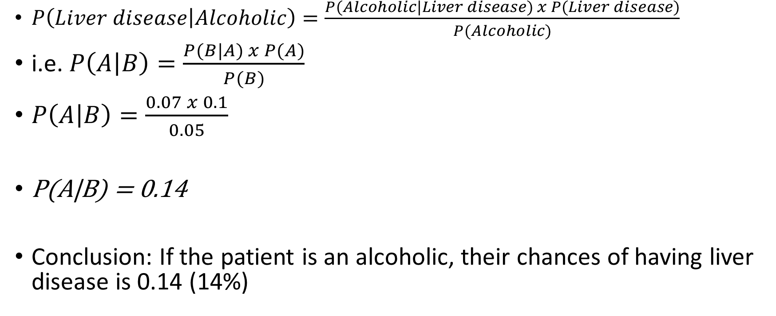
Bayes Theorem Example
$P\left(Liver disease | Alcoholic\right)=\frac{P(Alcoholic|Liver disease) x P(Liver disease)}{P(Alcoholic)}$
i.e. $P\left(A | B\right)=\frac{P(B|A) x P(A)}{P(B)}$
$P\left(A | B\right)=\frac{0.07 x 0.1}{0.05}$
P(A|B) = 0.14
Conclusion: If the patient is an alcoholic, their chances of having liver disease is 0.14 (14%)

Slide 7
Bayes Theorem Example
Rain prediction
Overall historical probability of rain: P(R) = 0.30
Sky condition
P(Overcast|Rain) = 0.8
P(Clear-sky|Rain) = 0.2
P(Overcast) = 0.6
Find P(Rain|Overcast), because today it is overcast
Suppose A = Rain, B = Overcast sky condition

Slide 8
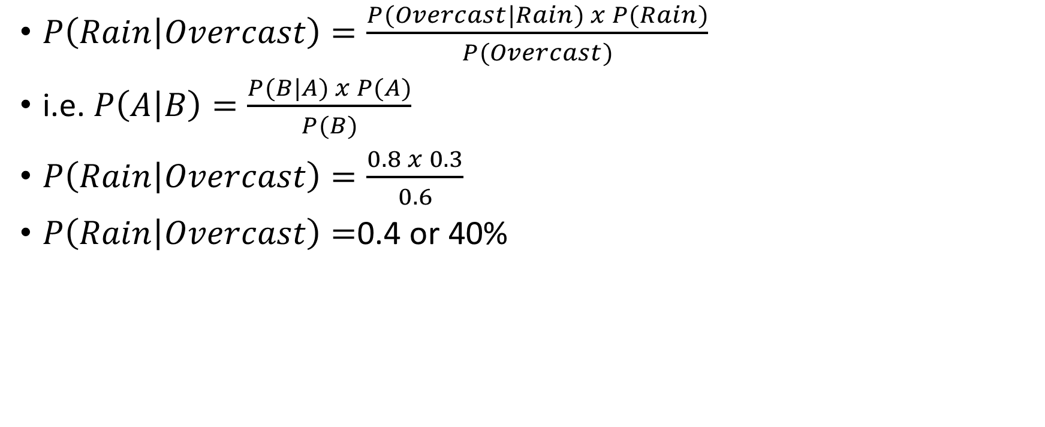
Bayes Theorem Example
$P\left(Rain | Overcast\right)=\frac{P(Overcast|Rain) x P(Rain)}{P(Overcast)}$
i.e. $P\left(A | B\right)=\frac{P(B|A) x P(A)}{P(B)}$
$P\left(Rain | Overcast\right)=\frac{0.8 x 0.3}{0.6}$
$P\left(Rain | Overcast\right)=$0.4 or 40%

Slide 9
Machine Learning Basics

Slide 10
Machine Learning
Machine Learning (ML): Enable computers to learn themselves
How? From past data
And? Adapt to new information
Advantage: No need to program them for each situation
Subset of Artificial Intelligence (AI)
Three types: (1) Supervised, (2) Unsupervised, (3) Reinforcement

Slide 11
Supervised and Unsupervised Machine Learning
Cust Id | Tr Amt | Tr Type | … | Fraud?
6789 | 10000 | Shop | … | N
1234 | 12500 | Hotel | … | Y
… | … | … | … | …
2345 | 3000 | Petrol | … | N
Cust Id | Loan Amt | Income | Emp Status | … | Default?
8901 | 25 L | 5 L | Emp | … | ?
3456 | 10 L | 8 L | Emp | … | ?
… | … | … | … | … | …
4567 | 95 L | 15 L | Bus | … | ?
Features
Label

Slide 12
Supervised Machine Learning
Labelled dataset is used here to train the ML algorithm
Scenario: Credit card fraud
Features (Inputs): Transaction amount, Transaction type, Time, Location, …
Label (Output): Fraud? (Yes/No)

Slide 13
Supervised Machine Learning Algorithms
Linear Regression: Predicting house prices based on features like square footage, number of bedrooms
Logistic Regression: Binary classification problems, like predicting whether an email is spam or not
Support Vector Machines (SVM): Image classification, text classification
Decision Trees: Customer churn prediction, classification tasks
K-Nearest Neighbors (KNN): Handwriting recognition, recommendation systems
Naive Bayes: Spam detection, text classification

Slide 14
Unsupervised Machine Learning
Unlabelled dataset is used here to train the ML algorithm
The ML algorithm discovers inherent patterns in the data without predicting output labels
Scenario: Loan default prediction
Features (Inputs): Loan amount, Income, Employment type
Output: ?
Possible solution: We will need to group similar customers into clusters

Slide 15
Unsupervised Machine Learning Algorithms
K-Means Clustering: Customer segmentation, image compression
Principal Component Analysis (PCA): Dimensionality reduction, pattern recognition
Association Rule Mining (e.g., Apriori): Market basket analysis, recommendation systems
K-Means Clustering: Customer Segmentation

Slide 16
Bayes Theorem and Naïve Bayes Classifier
Bayes' theorem describes how to update probabilities when new evidence becomes available
Naive Bayes refers to a specific machine learning algorithm, which is based on Bayes' theorem – Used to make decisions
Generally used for classification: Email spam/not, Transaction ok/fraud …
Works on features (See next slide)
Imagine a detective trying to solve a case: Which clues are important?
Similarly, Naiive Bayes asks: Which features are important?
Called Naiive because it assumes that all the features are independent

Slide 17
Features
Features provide information that a machine learning model needs to learn patterns and make predictions
Example: To decide the heart condition of a patient, features could be age, family history, eating habits, exercise, addictions, sleeping patterns, pathological parameters etc

Slide 18
Naïve Bayes Types
Gaussian Naive Bayes: Assumes that features follow a Gaussian (normal) distribution (Example: Height, Weight, etc); so less effective with categorical data
Multinomial Naive Bayes: Suitable for discrete data, often used in text classification with word frequencies
Bernoulli Naive Bayes: Designed for binary/boolean features, useful for text classification with binary attributes
Complement Naive Bayes: An adaptation that works well on imbalanced datasets
Text Classification: Commonly used for text classification tasks such as spam detection, sentiment analysis, and document categorization

Slide 19
Classification Workflow
Data
Training Set
Testing Set
Performance measures:
Accuracy
Precision
Recall
Model Development
Model Evaluation

Slide 20
Confusion Matrix Concept
Confusion matrix: A table used to understand how well an algorithm is doing at classifying data
Tells us how accurate our predictions are
The confusion matrix provides valuable insights into the model's accuracy, precision, recall, and other important metrics
Generally it is a 2x2 table

Slide 21
Confusion Matrix Example
An algorithm looks at 100 pictures of fruits and classifies them as apples or non-apples
Terminology: Next slide
Actual | Predicted
 | Apple | Non-apple
Apple | 11 (TP) | 9 (FP)
Non-apple | 5 (FN) | 75 (TN)

Slide 22
TP, TN, FP, FN
True Positive (TP): Identify a positive case as positive correctly
Apple identified as Apple
True Negative (TN) : Identify a negative case as negative correctly
Non-apple identified as Non-apple
False Positive (FP): Incorrectly identify a negative case as positive = Type-I error
Non-apple identified by mistake as Apple
False Negative (FN): Incorrectly identify a positive case as negative = Type-II error
Apple identified by mistake as Non-apple

Slide 23
Email Example
Suppose you have a dataset with 100 emails, and your model makes predictions for each email. Here are the results:
True Positives (TP): 35 emails were correctly classified as spam
True Negatives (TN): 50 emails were correctly classified as not spam
False Positives (FP): 5 emails were incorrectly classified as spam (actually not spam)
False Negatives (FN): 10 emails were incorrectly classified as not spam (actually spam)
 | Predicted Spam (Positive) Not Spam (Negative) |  | Total
Actual Spam Actual Not Spam | 35 (TP) | 10 (FN) | 45
 | 5 (FP) | 50 (TN) | 55
Total | 40 | 60 | 100

Slide 24
Use of Confusion Matrix
Consider the following situation in a cancer clinic and prepare a confusion matrix:
9 patients have cancer and the cancer test also says they have cancer
1 patient has cancer but the cancer test says could not detect it
99 patients do not have cancer but the cancer test says they have cancer
891 patients do not have cancer and the cancer test also correctly says it

Slide 25
Confusion Matrix for the Cancer Patients Data
 | Predicted Positive Negative |  | Total
Actual Positive Actual Negative | 9 (TP) | 1 (FN) | 10
 | 99 (FP) | 891 (TN) | 990
Total | 108 | 892 | 1,000

Slide 26
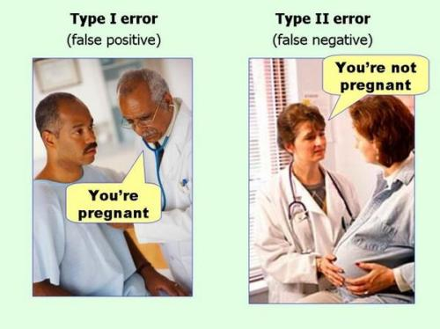
Type I and Type II Errors

Slide 27
Metrics Derived from Confusion Matrix
Accuracy: Measures the overall correctness of the model's predictions and is calculated as (TP + TN) / (TP + TN + FP + FN)
Precision (Positive Predictive Value): Measures the accuracy of positive predictions and is calculated as TP / (TP + FP)
Recall (Sensitivity or True Positive Rate): Measures the ability of the model to identify all positive instances and is calculated as TP / (TP + FN)
Specificity (True Negative Rate): Measures the ability of the model to identify all negative instances and is calculated as TN / (TN + FP)
F1 Score: It is the harmonic mean of precision and recall and provides a balance between the two metrics; and is calculated as 2 * (Precision * Recall) / (Precision + Recall)

Slide 28
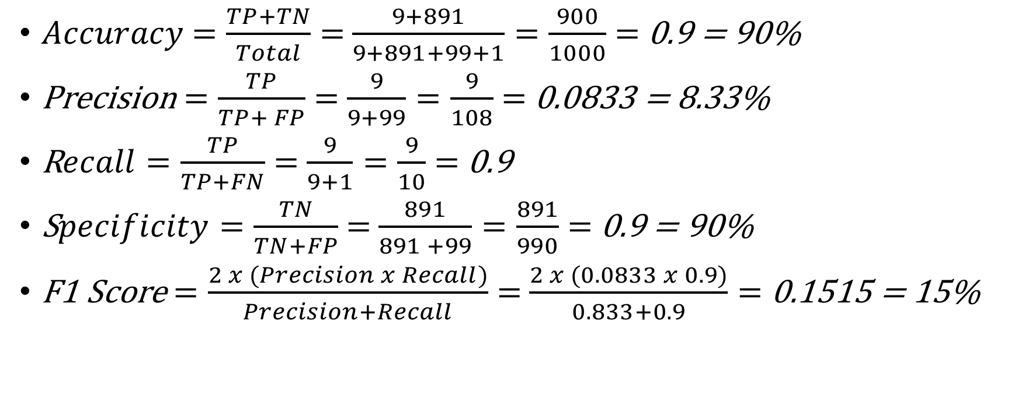
Metrics for Our Example
$Accuracy$ $=\frac{TP+TN}{Total}$ $=$ $\frac{9+891}{9+891+99+1}=\frac{900}{1000}$ $=$ 0.9 = 90%
Precision $=\frac{TP}{TP+ FP}$ $=$ $\frac{9}{9+99}=\frac{9}{108}$ $=$ 0.0833 = 8.33%
R$ecall=\frac{TP}{TP+FN}$ $=$ $\frac{9}{9+1}=\frac{9}{10}$ $=$ 0.9
S$pecificity=\frac{TN}{TN+FP}$ $=$ $\frac{891}{891 +99}=\frac{891}{990}$ $=$ 0.9 = 90%
F1 Score $=\frac{2 x (Precision x Recall)}{Precision+Recall}$ $=$ $\frac{2 x (0.0833 x 0.9)}{0.833+0.9}=$0.1515 = 15%

